Slide 1
Car Price Prediction Project.
Submitted by : Vijay

Slide 2
Problem Statement
In such a competitive market retaining customers and winning trust is a very big challenge
Understanding various factors that influence the car price
Understanding customers’ perceptions regarding selected online retailers.

Slide 3
Data Visualization and analysis
In this step we will analyze and visualize our data
We will use tools available in python for data analysis and visualization.
We will use NumPy for Numerical analysis
Pandas for performing operation on data frame
Matplotlib Provide visualization capability.
We will use Seaborn for more enhanced visualization and analysis

Slide 4
Dataset For This Project
For This Project, We Are Using The Dataset Is Collected By The Cardekho.Com Here We Collect The Around 5000 Cars Data Which Contains The 20 Features And We Collect The Data From Different States So The Model Shows The Right Prediction.

Slide 5
EDA Steps
During EDA we have performed many types of transformations to create the dataset.
After That we will see the shape of the data and check the null values present in the data.
Data is having Some null values and all the data is a different data type.
As the data is a Different data type we will perform the various type of plots.

Slide 6
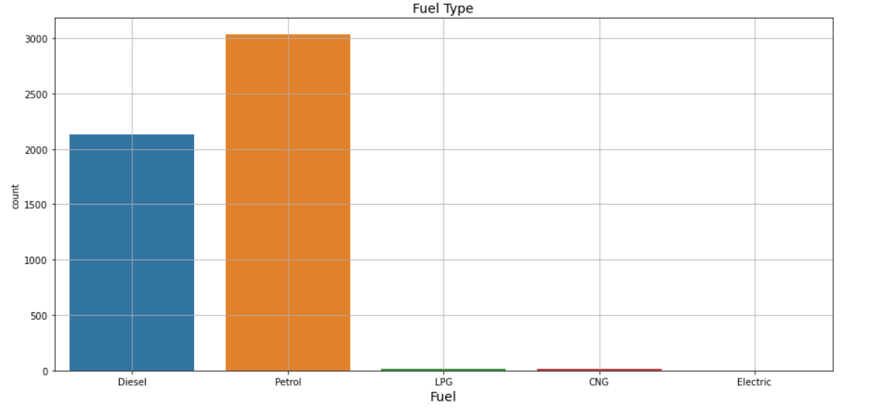
Here We See That The Petrol Fuel Cars Is Highly Demand In The Market.

Slide 7
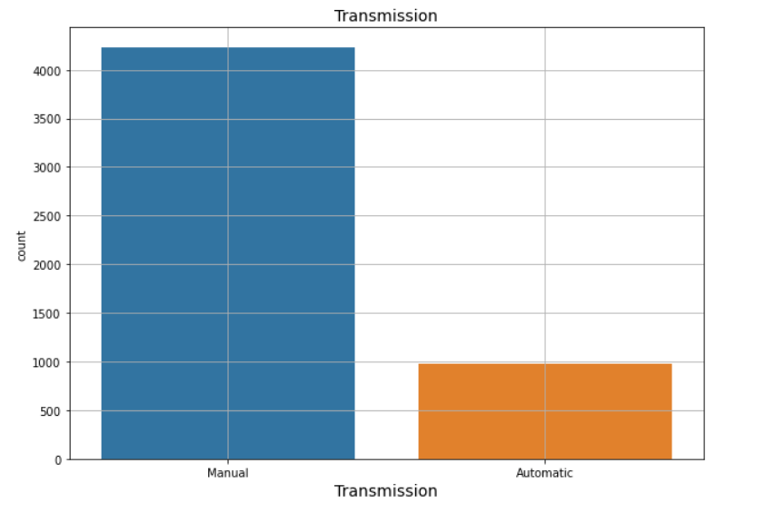
Here We See That The Transmission Of The Cars. Manual Transmission Cars Is Highly Demand In The Market.

Slide 8
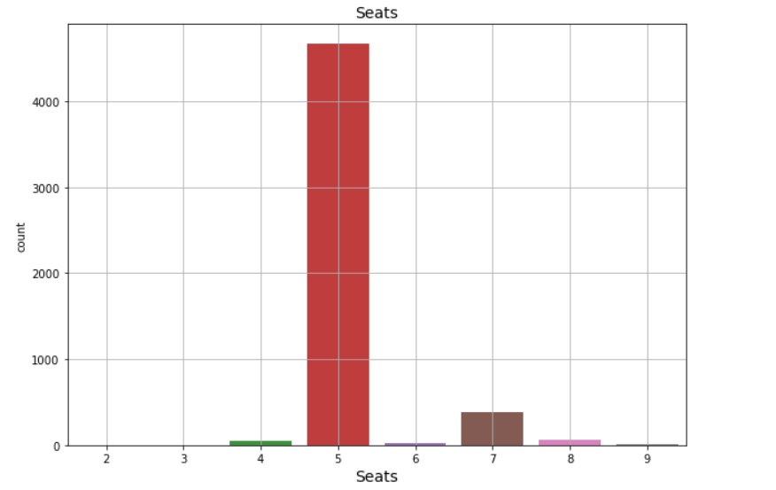
Number Of Sheets Is A Big Factor That Impact The Price Of The Car And Here We See That The 5-Seater Cars Is Highly Demanded In The Market.

Slide 9
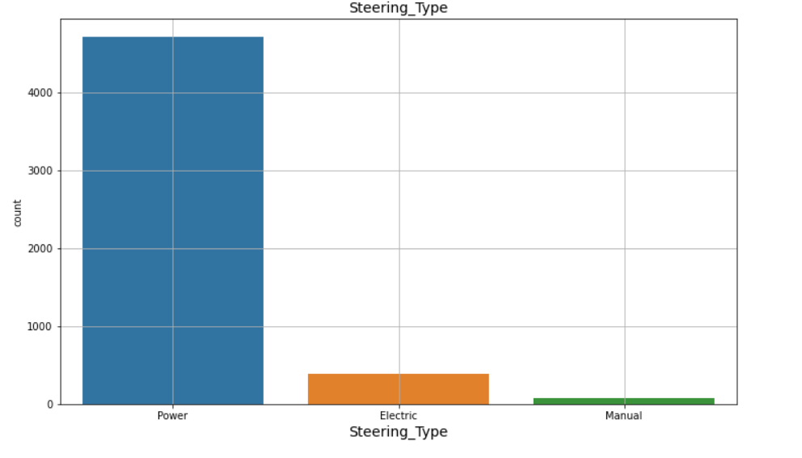
Here We See That The Power Steering Cars Is Highly Demand In The Market

Slide 10
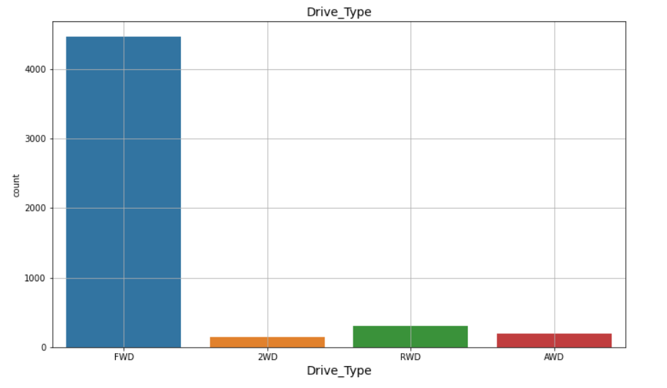
Here We See That The Front Wheel Drive Cars Is Highly Demand In The Market

Slide 11
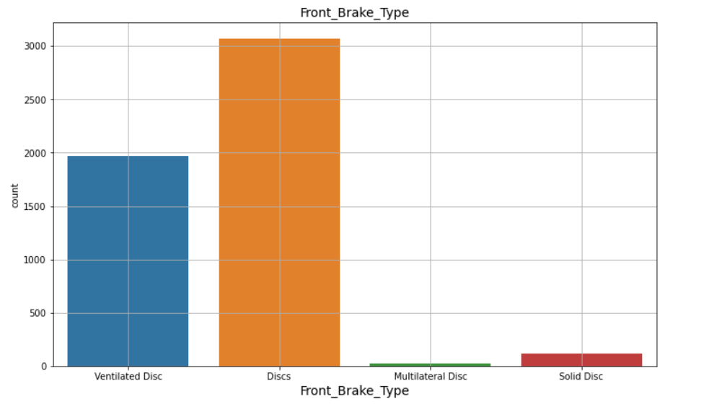
In This Chart, We See That The Front Brake Types Of Cars Is Highly Demand In The Market And We See That The Discs Brake Types Is Highly Demanded.

Slide 12
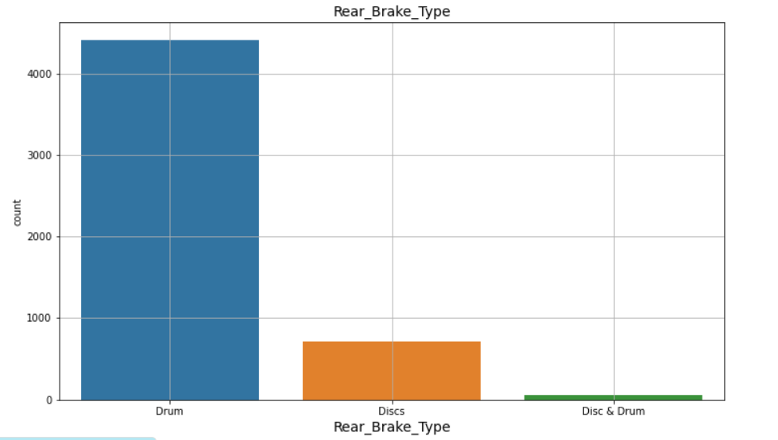
In This Chart, We See That The Rear Brake Types Of Cars Is Highly Demand In The Market And We See That The Drum Brake Types Is Highly Demanded.

Slide 13
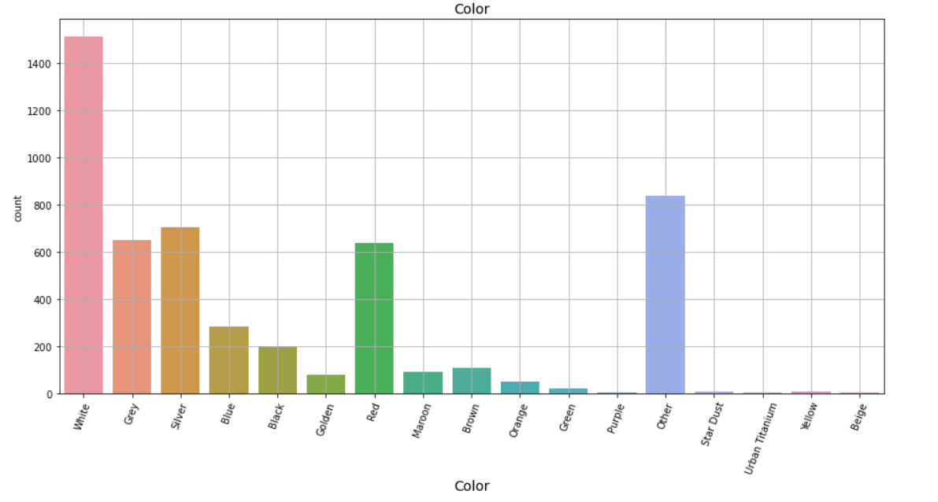
In This Chart, We See That The Color Types Of Cars Is Highly Demand In The Market And We See That The White Color Cars Is Highly Demanded.

Slide 14
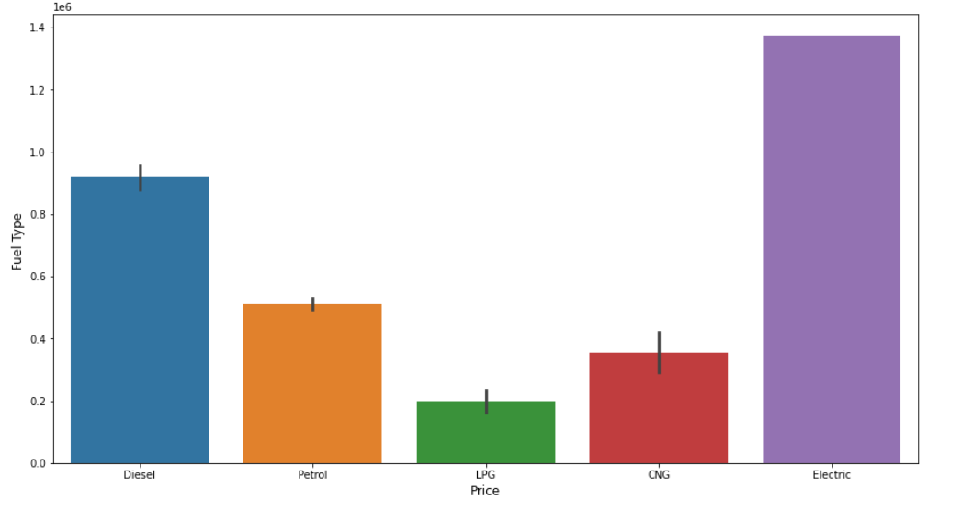
In This Chart, We See That The Electric Cars Is High Price In The Market.

Slide 15
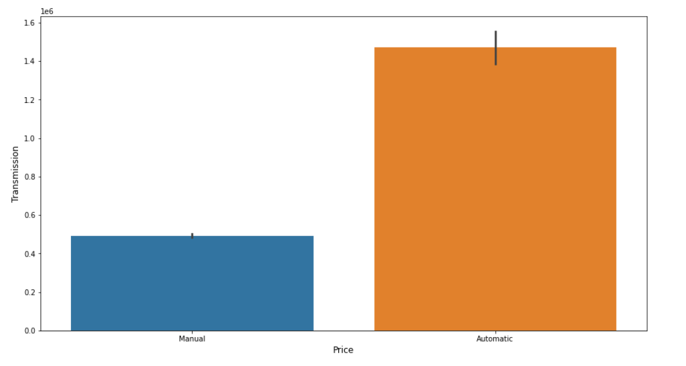
In This Chart, We See That The Automatic Cars Is High Price In The Market.

Slide 16
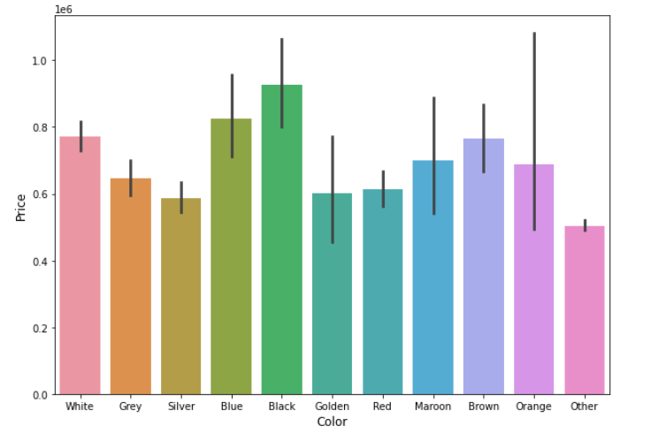
In This Chart, We See That The Black Color Cars Is High Price In The Market.

Slide 17
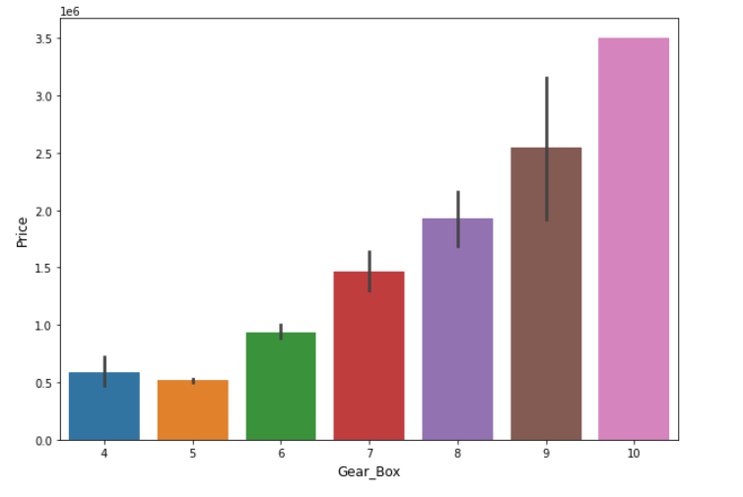
In This Chart, We See That The Which Cars Have Higher Gear Box That Cars Is High Price In The Market

Slide 18
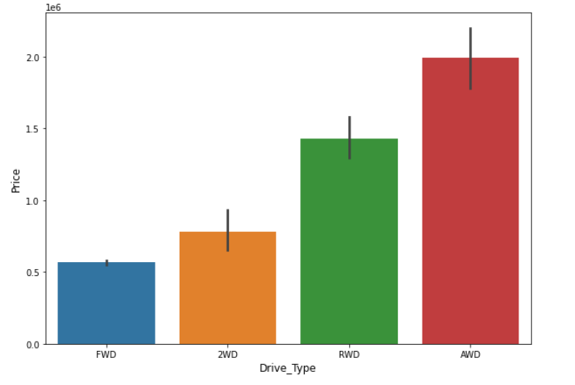
In This Chart, We See That The All-Wheel-Drive Cars Is High Price In The Market.

Slide 19
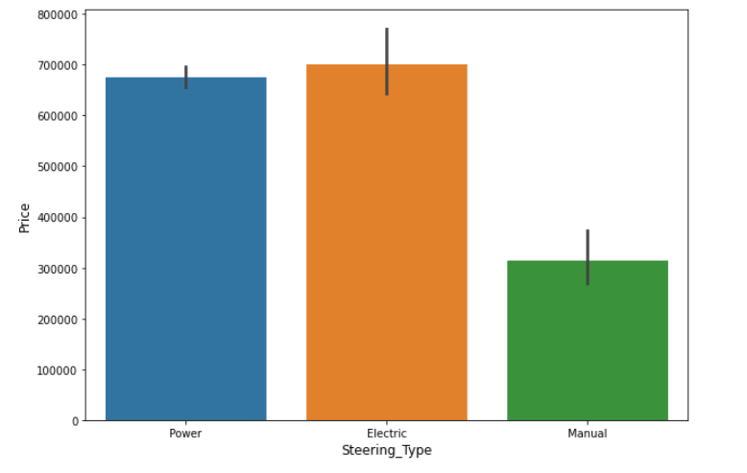
In This Chart, We See That The Electric Steering Type Cars Is High Price In The Market

Slide 20
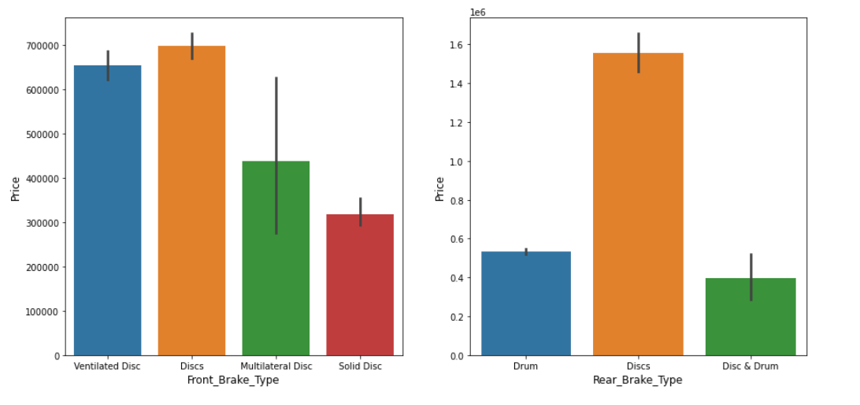
In This Chart, We See That Dics Brake Type Cars Is High Price In The Market

Slide 21
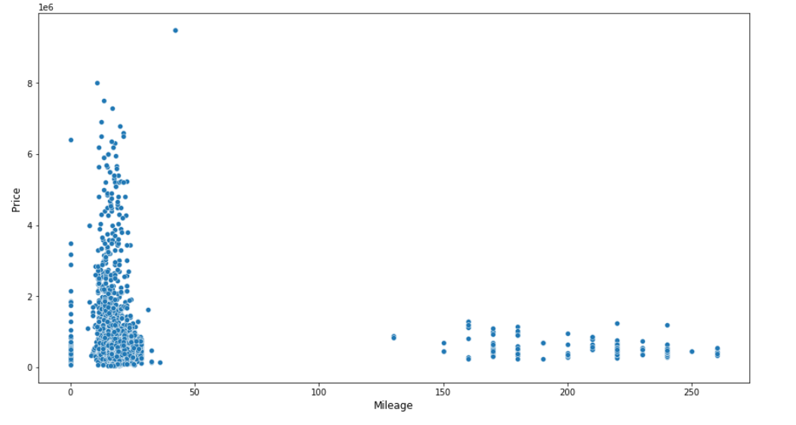
In This Chart, We See That Those Cars Have Low Mileage They Cars Is High Price In The Market.

Slide 22
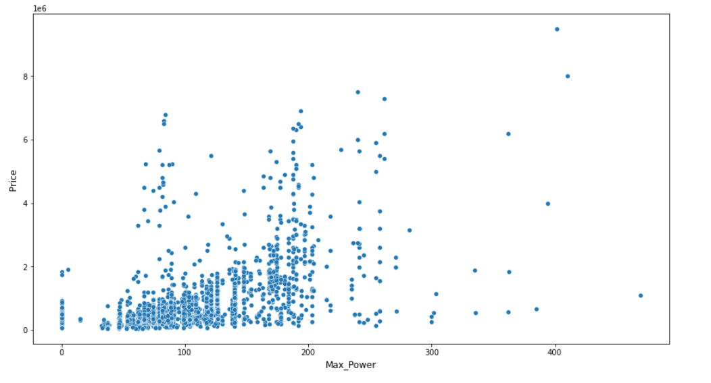
In This Chart, We See That Those Cars Have High Power They Cars Is High Price In The Market.

Slide 23
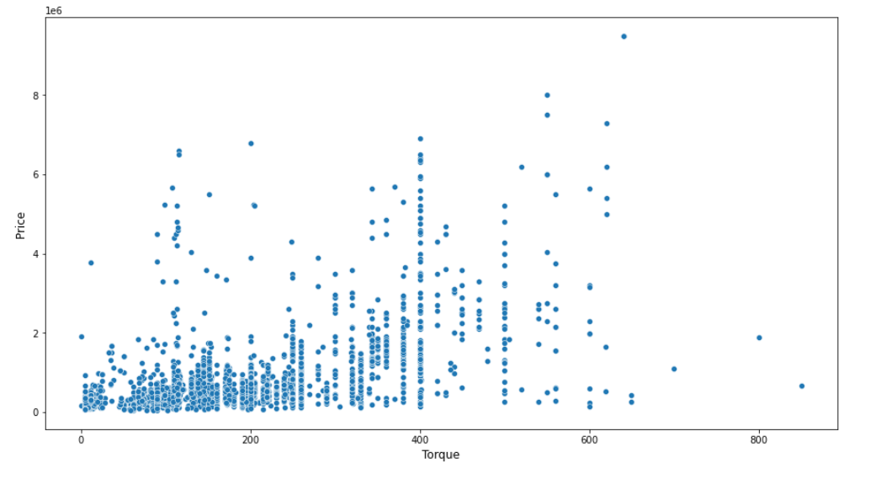
In This Chart, We See That Those Cars Have High Torque They Cars Is High Price In The Market.

Slide 24
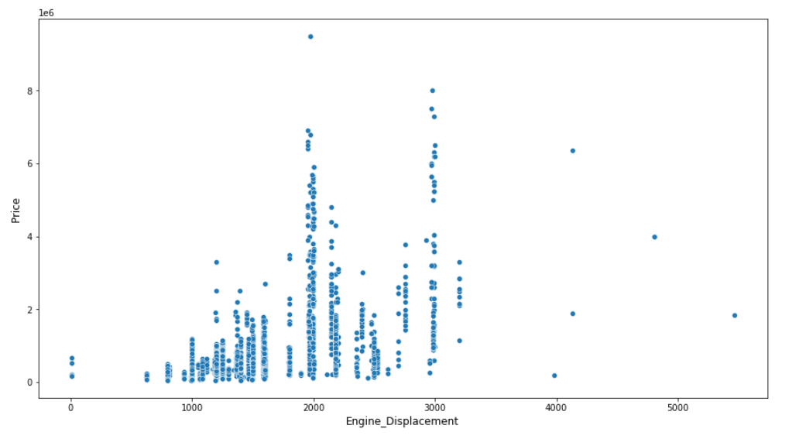
In This Chart, We See That Those Cars Have Medium Engine Displacement They Cars Is High Price In The Market.

Slide 25
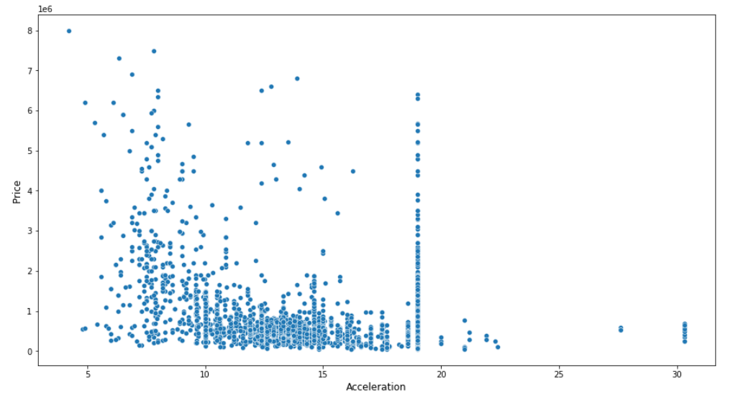
In This Chart, We See That Those Cars Have Low Acceleration They Cars Is High Price In The Market.

Slide 26
Conclusion
With the increase in automobiles, Every company trying to capture the marketplace, and automobiles company capture the market by launching new cars that are based on client feedback so they can increase the same and also retain the client and Give the best price. By performing different ML models, we aim to get a better result or less error with max accuracy.

